Slide 1

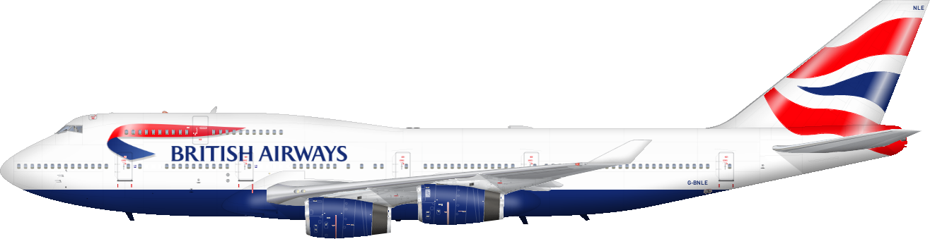

Raja Sekhar Rapaka

Slide 2

Introduction
British Airways (BA) is the flag carrier airline of the United Kingdom (UK). Every day, thousands of BA flights arrive to and depart from the UK, carrying customers across the world. Whether it’s for holidays, work or any other reason, the end-to-end process of scheduling, planning, boarding, fueling, transporting, landing, and continuously running flights on time, efficiently and with top-class customer service is a huge task with many highly important responsibilities.

Slide 3
Problem Statement
Customers are more empowered than ever because they have access to a wealth of information at their fingertips. This is one of the reasons the buying cycle is very different to what it used to be. Today, if you’re hoping that a customer purchases your flights or holidays as they come into the airport, you’ve already lost! Being reactive in this situation is not ideal, airlines must be proactive in order to acquire customers before they embark on their holiday.
This is possible with the use of data and predictive models. The most important factor with a predictive model is the quality of the data you use to train the machine learning algorithms. For this task, you must manipulate and prepare the provided customer booking data so that you can build a high-quality predictive model.
With your predictive model, it is important to interpret the results in order to understand how “predictive” the data really was and whether we can feasibly use it to predict the target outcome (customers buying holidays). Therefore, you should evaluate the model's performance and output how each variable contributes to the predictive model's power.
Objective
Using customer data and predictive models to help British Airways acquire customers before they embark on their holidays

Slide 4
Procedure
Explore and prepare the dataset
Train a machine learning model
Evaluate model and present findings

Slide 5

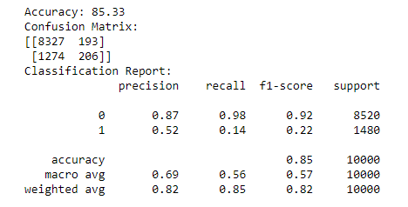
Random Forest Classifier

Slide 6
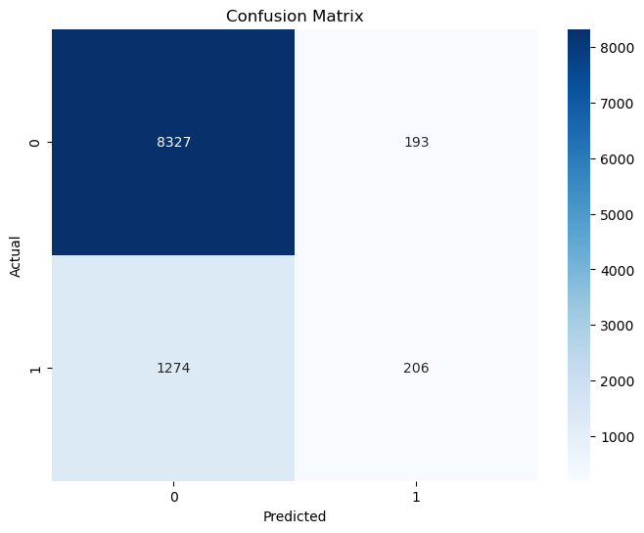
Confusion Matrix:
Accuracy in Negative Predictions: The model correctly identified 8,327 out of 8,520 negative instances, indicating strong performance in predicting the negative class.
High False Negative Rate: The model failed to correctly identify 1,274 out of 1,480 positive instances, which is concerning for applications where missing positive cases has significant consequences.

Slide 7
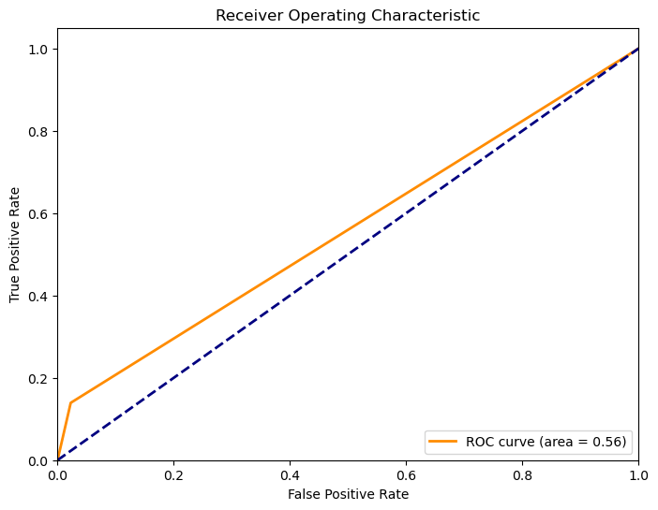
ROC Curve:
AUC of 0.56: The model's AUC value is just above 0.5, suggesting that it performs only slightly better than random guessing in distinguishing between positive and negative cases.
Limited Discrimination Ability: The curve is close to the diagonal line, indicating that the model has poor ability to discriminate between true positive and false positive rates.

Slide 8
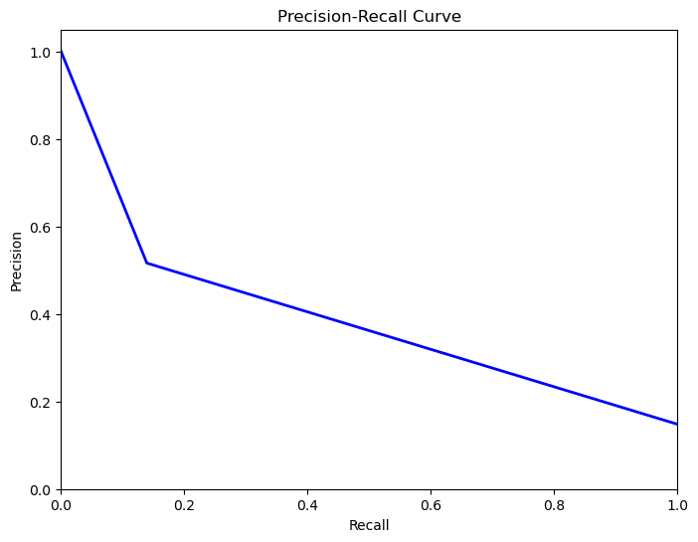
Precision-Recall Curve:
High Precision at Low Recall: The model is very precise when recall is low, meaning when it predicts a positive, it's usually correct, but it doesn't catch many positive cases.
Significant Drop in Precision with Higher Recall: As the model tries to increase recall (capture more positives), precision drops sharply, indicating a trade-off where more false positives are introduced.

Slide 9
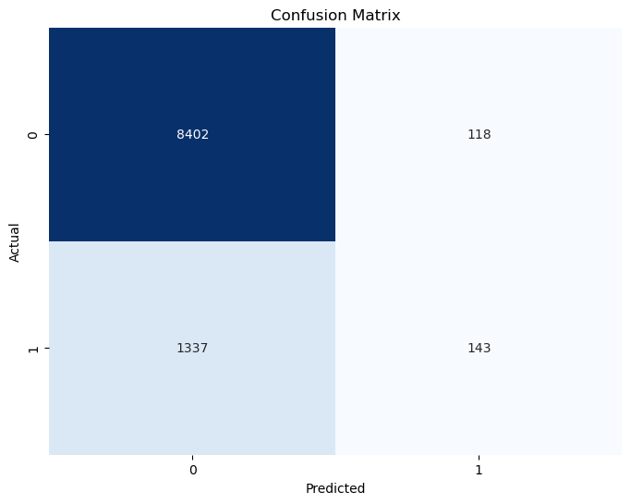
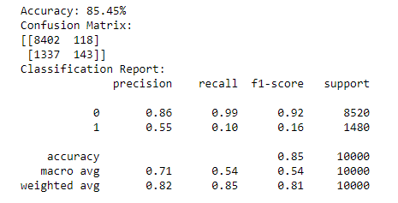
XG Boost Model
Confusion Matrix
Metrics

Slide 10

Conclusion
Route
Booking Origin
Flight Duration
Wants Extra Baggage
Length of Stay
are the top 5 features which influence Customer buying behavior
To solve the problem, I suggest to :
Provide attractive offers such as getting a higher discount if customer order before 30 days of flight.
Provide rescheduling options to customers with a maximum deadline of 3 days before the flight.

Slide 11
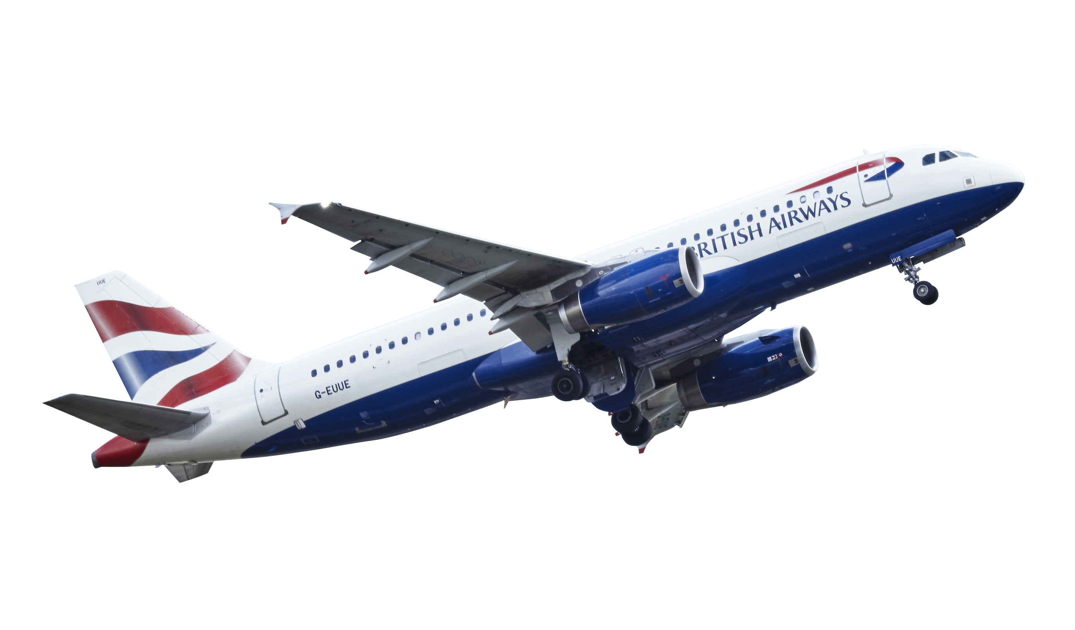
Thank You

